Slide 1
Population Dynamics
APES Year End Review

Slide 2
Global Population
2007: 6,625,000,000 (1.2% growth rate)
2008: 6,705,000,000 (1.2% growth rate)
2009: 6,810,000,000 (1.2% growth rate)
2010: 6,818,300,000 (estimated)

Slide 3
Population growth affects the environment
The IPAT model: I = P x A x T x S
Our total impact (I) on the environment results from the interaction of population (P), affluence (A) and technology (T), with an added sensitivity (S) factor
Population = individuals need space and resources
Affluence = greater per capita resource use
Technology = increased exploitation of resources
Sensitivity = how sensitive an area is to human pressure
Further model refinements include education, laws, ethics
Humanity uses 1/3 of all the Earth’s net primary production

Slide 4
Population Estimation Methods
Mark-Recapture Model | Model type | Description
Lincoln-Peterson Method | Closed population | Fisheries origin, one marking period
Schnabel Method | Closed population | Fisheries origin, multiple marking periods
Jolly-Seber Model | Open population | Multiple marking periods
Polluck’s Robust Design | Combination of closed and open models | During short periods of sampling closed assumptions, over the longitudinal study treated as open system

Slide 5
The Calculations
Given those conditions, estimated population size is:
N = Estimate of total population size
M = Total number of animals captured and marked on the first visit
C = Total number of animals captured on the second visit
R = Number of animals captured on the first visit that were then recaptured on the second visit
N = MC / R

Slide 6
Calculating The Growth Rate
Crude Growth Rate formula =
Crude Birth Rate – Crude Death Rate = Crude Growth Rate
Crude Rates are based on 1,000 individuals
Population Change Formula =
(birth rate + immigration rate) – (death rate + emigration rate) = Population Change
The CGR for the Earth is roughly 1.2% right now !

Slide 7
Total Fertility Rate (TFR)
The Total Fertility Rate or TFR is an estimate of the average number of children who will be born alive to a woman during her lifetime if she passes through all her childbearing years (ages 15-44) conforming to age-specific fertility rates of a given year.
In simpler terms, it is an estimate of the average number of children a woman will have during her childbearing years.

Slide 8
Replacement Level Fertility (RLF)
The Replacement Level Fertility or RLF is the number of children a couple must have to replace them.
The average for a country or the world usually is slightly higher than 2 children per couple (2.1 in the United States and 2.5 in some developing countries) because some children die before reaching their reproductive years.

Slide 9
Population Growth
Populations show two types of growth
Exponential
J-shaped curve
Unlimited Growth
Growth is independent of population density
Logistic
S-shaped curve
Growth affected by environmental stress
Growth is not independent of population density

Slide 10
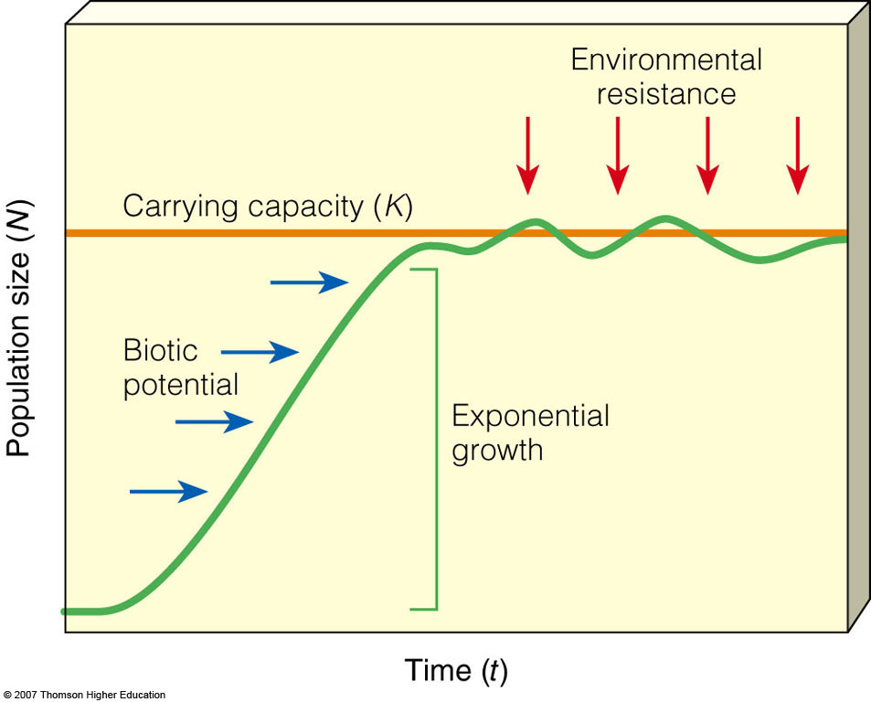
Exponential and Logistic Population Growth: J-Curves and S-Curves
Populations grow rapidly with ample resources, but as resources become limited, its growth rate slows and levels off.
Figure 8-4

Slide 11
Exponential Growth
N = N_{o}e^{rt} where
N_{o} is the initial population size
r is the rate of growth in decimal form
t is the time (same units as the rate of growth)
If the growth rate of an elephant population is 2%, starting with one male and one female, how many elephants would you have in 250 years?
297 elephants!

Slide 12
Rule of 70
To determine the doubling time of a population, divide 70 by the percentage of growth.
Uses the exponential growth calculation
If the growth rate is 2%, then,
70 ÷ 2 = 35 years

Slide 13
Carrying Capacity (K)
Exponential curve is not realistic due to carrying capacity of area
Carrying capacity is maximum number of individuals a habitat can support over a given period of time due to environmental resistance (sustainability)

Slide 14
Environmental Resistance
Ability of populations of a given species to increase in size
Abiotic Contributing Factors:
Unfavorable light
Unfavorable Temperatures
Unfavorable chemical environment - nutrients
Biotic Contributing Factors:
Low reproductive rate
Specialized niche
Inability to migrate or disperse
Inadequate defense mechanisms
Inability to cope with adverse conditions

Slide 15
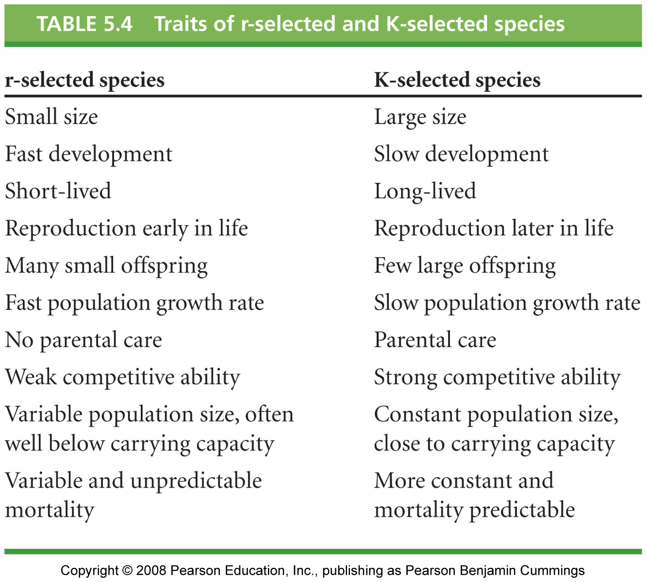
K-selected vs. r-selected species

Slide 16
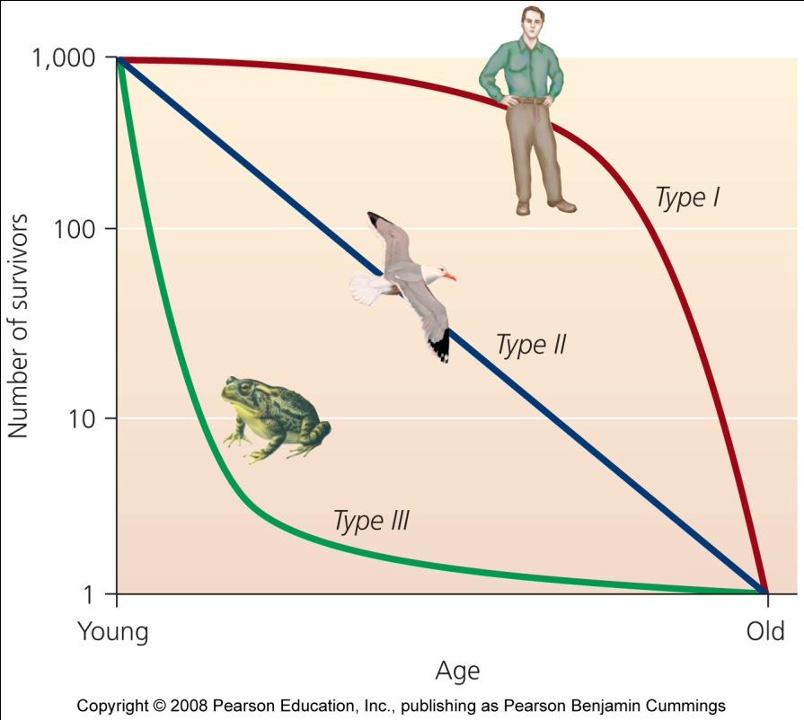
Survivorship curves
Type I: late loss, K-strategists that produce few young and care for them until they reach reproductive age thus reducing juvenile mortality
Type II: constant loss, typically intermediate reproductive strategies with fairly constant mortality throughout all age classes
Type III: r-strategists with many offspring, high infant mortality and high survivorship once a certain size and age

Slide 17
Age Structure
The age structure of a population is usually shown graphically
The population is usually divided up into prereproductives, reproductives and postreproductives
The age structure of a population dictates whether is will grow, shrink, or stay the same size

Slide 18
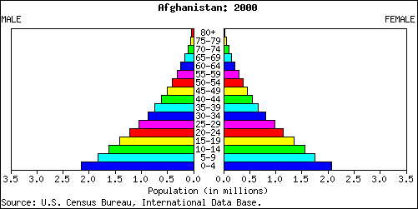
Population pyramids are used to show information about the age and gender of people in a specific country.
Male
Female
There is also a high Death Rate.
In this country there is a high Birth Rate
Population in millions
This population pyramid is typical of countries in poorer parts of the world (LEDCs.)

Slide 19
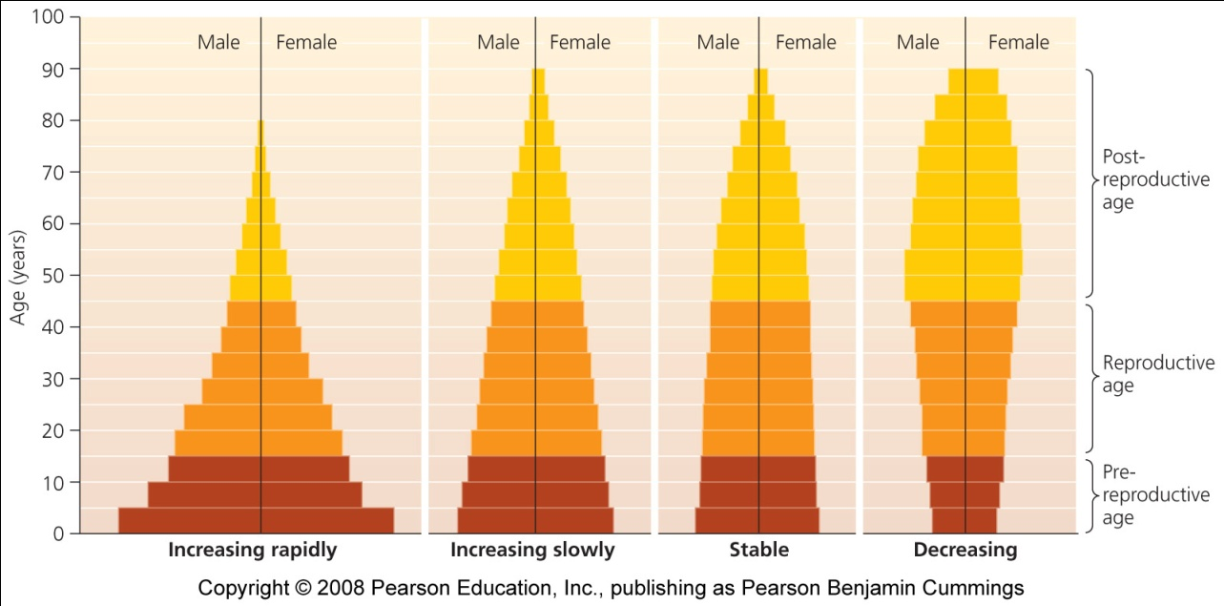
Population characteristics

Slide 20
Age Structure: Young Populations Can Grow Fast
How fast a population grows or declines depends on its age structure.
Prereproductive age: not mature enough to reproduce.
Reproductive age: those capable of reproduction.
Postreproductive age: those too old to reproduce.

Slide 21
The demographic transition
Demographic transition = a model of economic and cultural change to explain the declining death and birth rates in industrializing nations
Stable preindustrial state of high birth and death rates change to a stable post-industrial state of low birth and death rates
As mortality decreases, there is less need for large families
Parents invest in quality of life

Slide 22
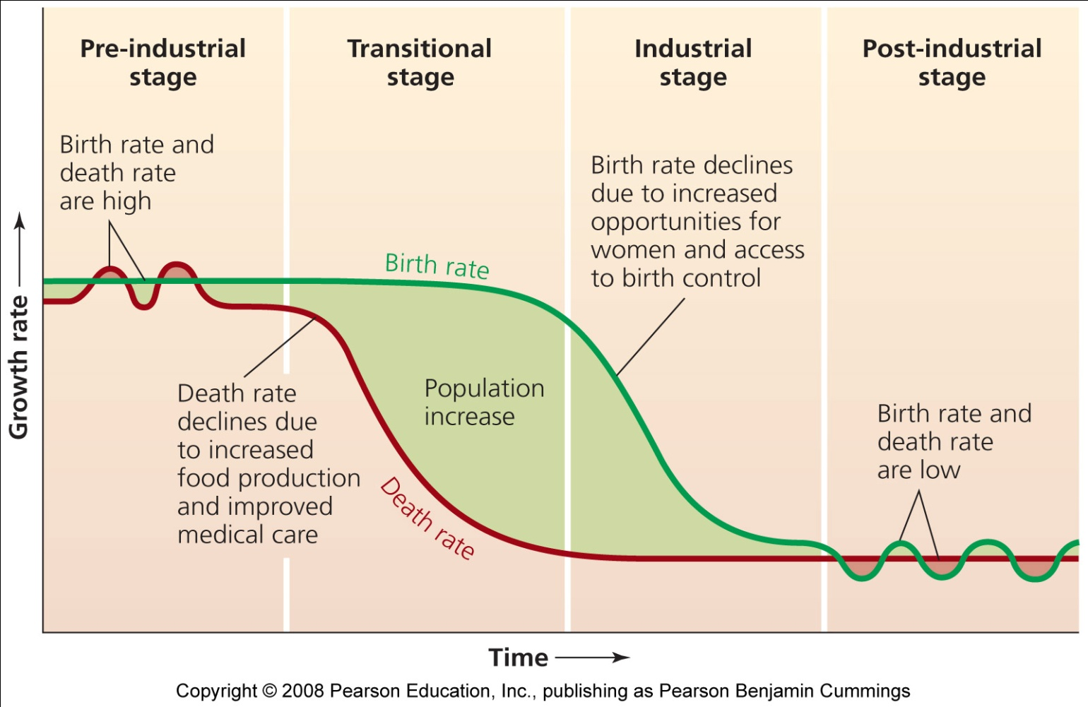
The demographic transition’s four stages
Population growth is seen as a temporary phenomenon

Slide 23
The International Conference on Population and Development
In 1994 Cairo, Egypt, 179 nations called on all governments to offer universal access to reproductive health care within 20 years
Offer better education and health care and alleviate poverty, disease, and sexism
Despite the success of family planning, recent Republican administrations in the U.S. have declined to fund family-planning efforts
George W. Bush cancelled funding as one of his first acts on becoming U.S. president in 2001

Slide 24
Conclusion
The human population is larger than at any time in the past and getting older
Populations are still rising, even with decreasing growth rates
Most developed nations have passed through the demographic transition
Expanding rights for women slows population growth
Will the population stop rising through the demographic transition, restrictive governmental intervention, or disease and social conflict caused by overcrowding and competition?
Sustainability requires a stabilized population in time to avoid destroying natural systems

Slide 25
Urban Growth vs. Urbanization
Urbanization refers to the percentage of people in a country who live in an urban area.
Urban growth refers to the rate of increase of an urban population.

Slide 26
Shift from agriculture
One of the reasons for this shift, is that with the technological revolution, less farmers are needed to provide food for the masses.
People move into the cities for work.
The portion of the global population that was considered urban was up to 49% in 2005.

Slide 27
Rapid Growth
The greatest rate of growth of these three areas is in the urban areas.
Government is concentrated in the cities.
Industry and commerce centers are in the cities.
Transportation junctions and mass transit is found in urban areas.
What other trend shows rapid growth?

Slide 28
5 Important Trends
1. The proportion of people living in urban areas is increasing.
From 1850 to 2006 the rate of growth has grown from 2% to 47.5%
2. The number of large urban areas is growing.
Megacities or megalopolises

Slide 29
Trends, continued
3. Urban population is increasing rapidly in developing countries.
This trend is leading to centers of poverty.
4. Urban growth is slower in developed countries.
Why do you think that is?
5. Poverty is becoming an urban trend as opposed to a rural one.

Slide 30
Urban Sprawl
When land is available and affordable, urban areas tend to sprawl outward because:
Federal government loan guarantees stimulated the development of suburbs.
Low-cost gasoline and government funding of highways encourages automobile use.
Tax-laws encourage home ownership.
Most zoning laws separate residential and commercial use of land.
Many urban areas lack proper planning.

Slide 31
Sprawl looks like this . . .
Low residential density
Distant Separation of homes, employment, schools, shopping
Lack of a city “center”
Street networks are hard to access

Slide 32
The problem here is,
Transportation
people are forced to drive, no mass transit
Pollution
increased pollution from driving cars, road maintenance
Health
promotes physical inactivity and obesity, stress, high blood pressure

Slide 33
More problems with sprawl
Land Use
more land is being converted from agricultural to residential, residential land is being proportioned at a high per capita rate
Economics
tax money is spent on new developments and upgrading existing services to meet the demand (where have we seen this?)

Slide 34
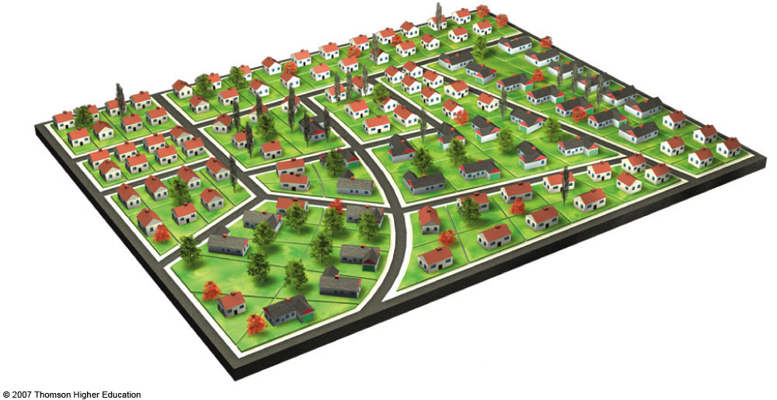
Typical housing development
Fig. 23-17b, p. 565
Notes:
Figure 23.17
Conventional and cluster housing developments as they might appear if constructed on the same land area. With cluster development, houses, town houses, condominiums, and two- to six-story apartments are built on part of the tract. The rest, typically 30–50% of the area, is left as open space, parks, and cycling and walking paths.

Slide 35
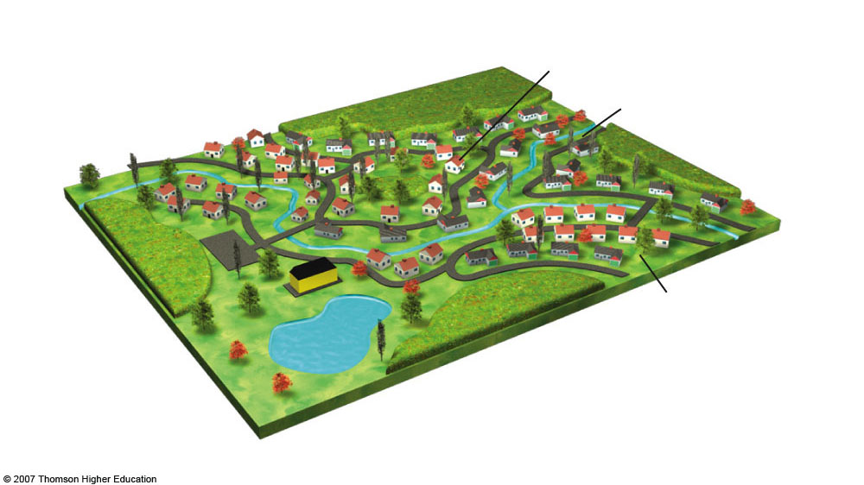
Cluster
Cluster housing development
Creek
Cluster
Pond
Fig. 23-17c, p. 565
Notes:
Figure 23.17
Conventional and cluster housing developments as they might appear if constructed on the same land area. With cluster development, houses, town houses, condominiums, and two- to six-story apartments are built on part of the tract. The rest, typically 30–50% of the area, is left as open space, parks, and cycling and walking paths.

Slide 36
Natural Capital Degradation
Urban Sprawl
Land and Biodiversity
Human Health and Aesthetics
Water
Energy, Air, and Climate
Economic Effects
Increased runoff
Loss of cropland
Contaminated drinking water and air
Increased surface water & groundwater pollution
Increased energy use & waste
Higher taxes
Loss of forests and grasslands
Increased air pollution
Decline of downtown business districts
Increased use of surface water and groundwater
Loss of wetlands
Weight gain
Increased greenhouse gas emissions
Loss and fragmentation of wildlife habitats
Noise pollution
Decreased storage of surface water and groundwater
Increased unemployment in central city
Sky illumination at night
Enhanced global warming
Increased wildlife roadkill
Increased flooding
Warmer microclimate (urban heat island effect)
Increased soil erosion
Traffic congestion
Decreased natural sewage treatment
Loss of tax base in central city
Fig. 23-6, p. 553
Notes:
Figure 23.6
Natural capital degradation: some undesirable impacts of urban sprawl or car-dependent development. QUESTION: Which five of these effects do you think are the most harmful?

Slide 37
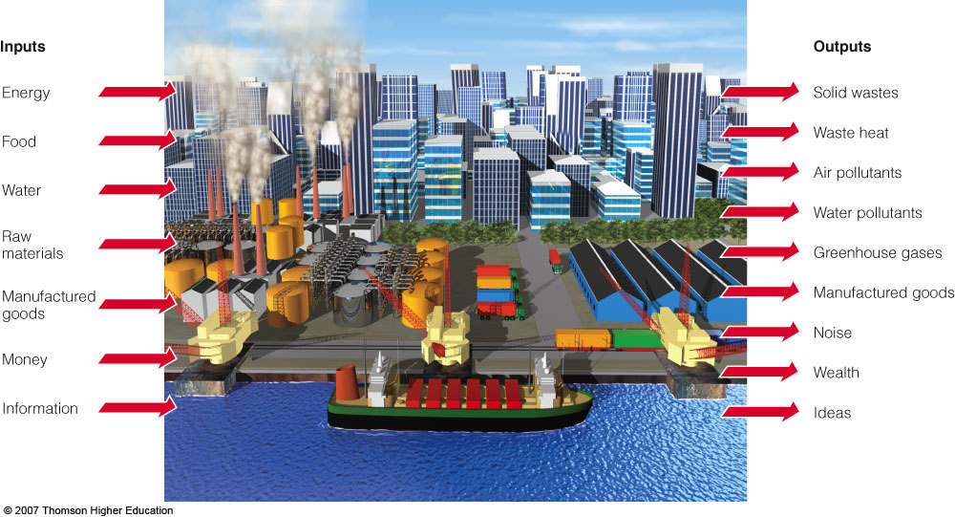
URBAN RESOURCE AND ENVIRONMENTAL PROBLEMS
Urban areas rarely are sustainable systems.
Figure 23-8

Slide 38
URBAN RESOURCE AND ENVIRONMENTAL PROBLEMS
Noise levels of some common sounds. Prolonged exposure to lower noise levels and occasional loud sounds can greatly increase internal stress.
Figure 23-9

Slide 39
The Ecocity Concept
Principles of sustainability:
Build cities for people not cars.
Use renewable energy resources.
Use solar-power living machines and wetlands for waste water treatment.
Depend largely on recycled water.
Use energy and matter efficiently.
Prevent pollution and reduce waste.
Reuse and recycle at least 60% of municipal solid waste.

Slide 40
The Ecocity Concept
Protect biodiversity by preserving, protecting, and restoring surrounding natural areas.
Promote urban gardens and farmers markets.
Build communities that promote cultural and economic diversity.
Use zoning and other tools to keep the human population and environmentally sustainable levels.

Slide 41
Microclimates
A microclimate is the climate of a small area that is different from the area around it. It may be warmer or colder, wetter or drier, or more or less prone to frosts.
Microclimates may be quite small - a protected courtyard next to a building, for example, that is warmer than an exposed field nearby. Or a microclimate may be extensive - a band extending several miles inland from a large body of water that moderates temperatures.

Slide 42
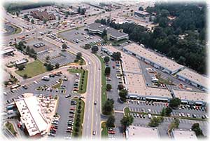
Impervious Surfaces & Urban Growth
As cities grow and more development occurs, the natural landscape is replaced by roads, buildings, housing developments, and parking lots.
The metro Atlanta region has experienced explosive growth over the last 50 years, and, along with it, large amounts of impervious surfaces have replaced the natural landscape.
Impervious surfaces can have an effect on local streams, both in water quality and stream flow and flooding characteristics.
Impervious surfaces can also affect the temperature of the region.

Slide 43
Urban
People often define urban areas, or cities, as land occupied by buildings and other structures used for residences and institutional and industrial sites.
Urban areas often have some form of public transportation, such as buses, subways, or trains and have high population densities.
Buildings are often closer together and built higher than those in suburban or rural areas.
Urban areas are highly populated.

Slide 44
Suburban
Suburban areas are those on the outskirts of cities.
Residents of suburban areas often commute to the cities for work. Some suburban areas have commuter trains and buses that shuttle people to and from the cities.
Structures in suburban communities are often lower and farther apart than in cities.
Though they have smaller populations than cities, suburbs offer the same services including schools, health care facilities, and public works.

Slide 45
Rural
The 2000 Census showed that 59 million people live in rural areas. These are areas with large amounts of land with significantly lower populations than urban or suburban areas.
Structures are often far apart and some rural communities share hospitals or schools.
Rural areas tend to be far from urban areas. Some examples of rural areas include farmland, woodland forests, plains, deserts, and prairies.

Slide 46
Increased Emissions
Elevated emissions of air pollutants and greenhouse gases: Increasing energy demand generally results in greater emissions of air pollutants and greenhouse gas emissions from power plants. Higher air temperatures also promote the formation of ground-level ozone.

Slide 47
Quality of Life
Compromised human health and comfort: Warmer days and nights, along with higher air pollution levels, can contribute to general discomfort, respiratory difficulties, heat cramps and exhaustion, non-fatal heat stroke, and heat-related mortality.

Slide 48
Water Quality
Impaired water quality: Hot pavement and rooftop surfaces transfer their excess heat to stormwater, which then drains into storm sewers and raises water temperatures as it is released into streams, rivers, ponds, and lakes. Rapid temperature changes can be stressful to aquatic ecosystems.

